Slide 1
Pavement Roughness Measurement Application: Project Plan
SDMAY20-17: Justin Kuennen, Greg Starr, Christian Royston,
Joe Van Treeck, Kyle Eckrich, Tanner Dempsay

Slide 2
Key Technical Goals
Calculate the International Roughness Index of the pavement using accelerometer data
Make calculation both on phone and on database
Determine the geographic location of the calculated IRI data
Take an image of the road when the calculation is complete
Store the IRI data with the geographic location and image on a NodeJS database
Display the calculated IRI data on a map overlay

Slide 3
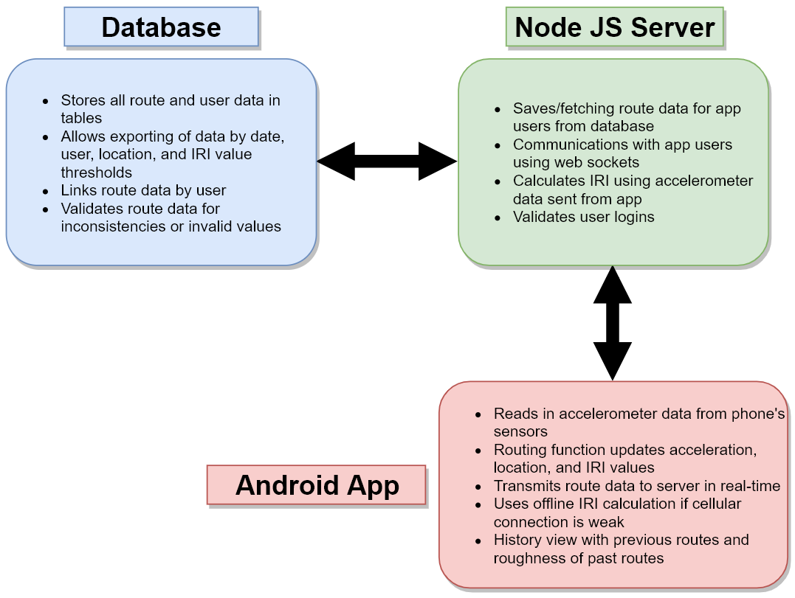
System Block Diagram of Proposed Project Design

Slide 4
Project Tasks
Create NodeJS server
Create database with tables for data types and attributes
Link server and database for data reading/writing functionality
Develop user-interface for Android app
Create networking framework for frontend to communicate with backend
Develop IRI calculation algorithm for acceleration data from Android phones
Implement algorithm on backend and frontend for online and offline functionality
Add GPS tracking and logging to Android app
Couple GPS and IRI data to create path histories for users.
System testing with frontend, backend, and database

Slide 5
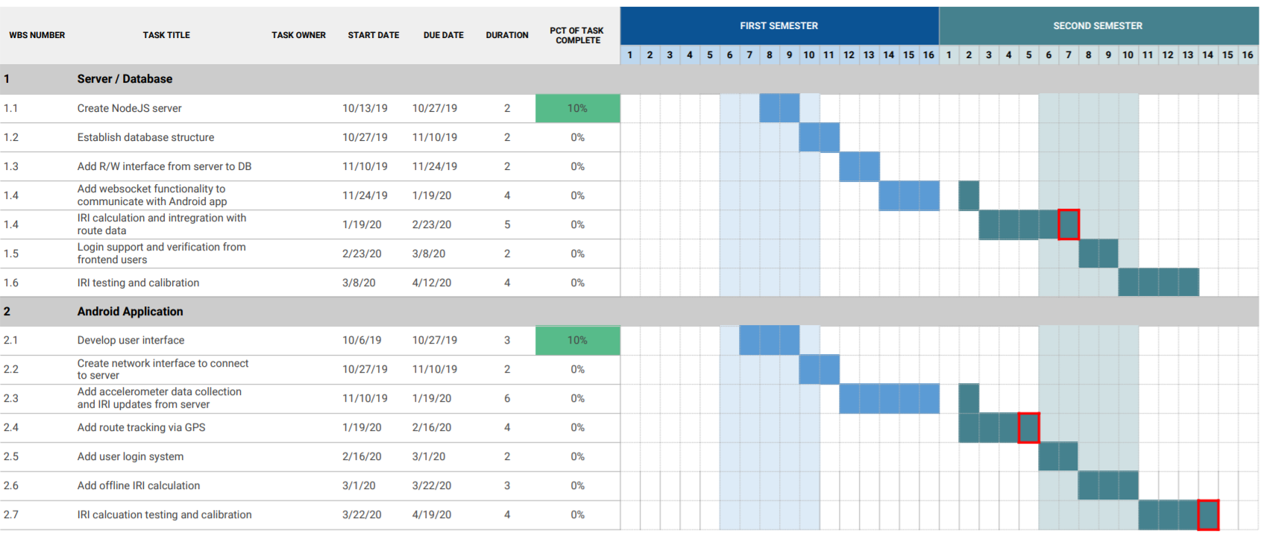
Project Timeline

